Slide 1

TABLEAU PROJECT
LONDON BICYCLE RIDES
DATE 30 July 2024
SUBMITTED TO : RAHUL GURNANI
SUBMITTED BY : Naresh Kumar

Slide 2
PROJECT OVERVIEW
Project Overview Data Source and Collection Data Origin:
Downloaded from Kaggle, collected from a government site.
Dataset Details: 17,414 rows and 10 columns.
Data Preparation and Cleaning Tools Used: Python Process: Data cleaning to ensure accuracy and consistency.
Data Analysis and Visualization Platform: Tableau Focus Areas: Temperature (t1 - actual, t2 - feels like)Bike ridership count (cnt)Weather conditions (weather_code)Wind speed (wind_speed)Temporal factors (holidays, weekends, seasons)
Dashboard Insights Objective: Analyze bike ridership patterns across London.
Key Visualization: Number of riders during specific time periods and weather conditions.

Slide 3
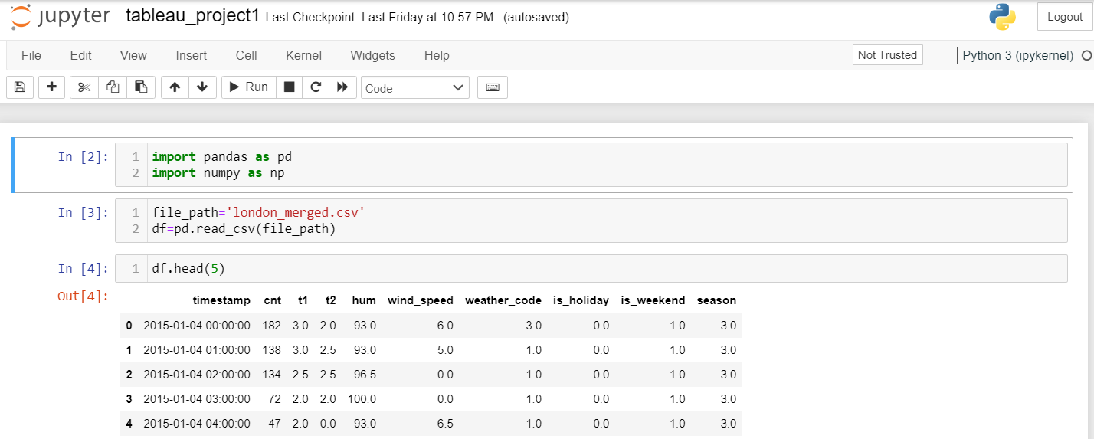
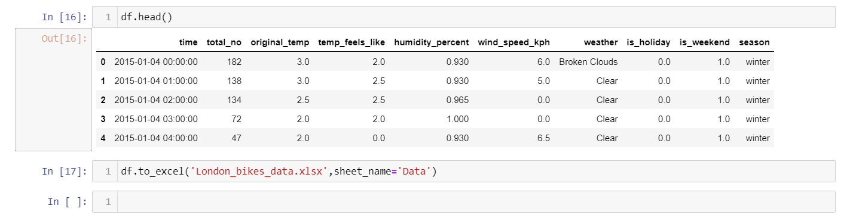

META DATA INFO
"timestamp" - timestamp field for grouping the data
"cnt" - the count of a new bike shares
"t1" - real temperature in C
"t2" - temperature in C "feels like"
"hum" - humidity in percentage
"wind_speed" - wind speed in km/h
"weather_code" - category of the weather
"is_holiday" - boolean field - 1 holiday / 0 non holiday
"is_weekend" - boolean field - 1 if the day is weekend
"season" - category field meteorological seasons: 0-spring ; 1-summer; 2-fall; 3-winter.
"weathe_code" category description:
1 = Clear ; mostly clear but have some values with haze/fog/patches of fog/ fog in vicinity
2 = scattered clouds / few clouds
3 = Broken clouds 4 = Cloudy 7 = Rain/ light Rain shower/ Light rain 10 = rain with thunderstorm 26 = snowfall 94 = Freezing Fog
UNCLEANED DATA
CLEANED DATA

Slide 4
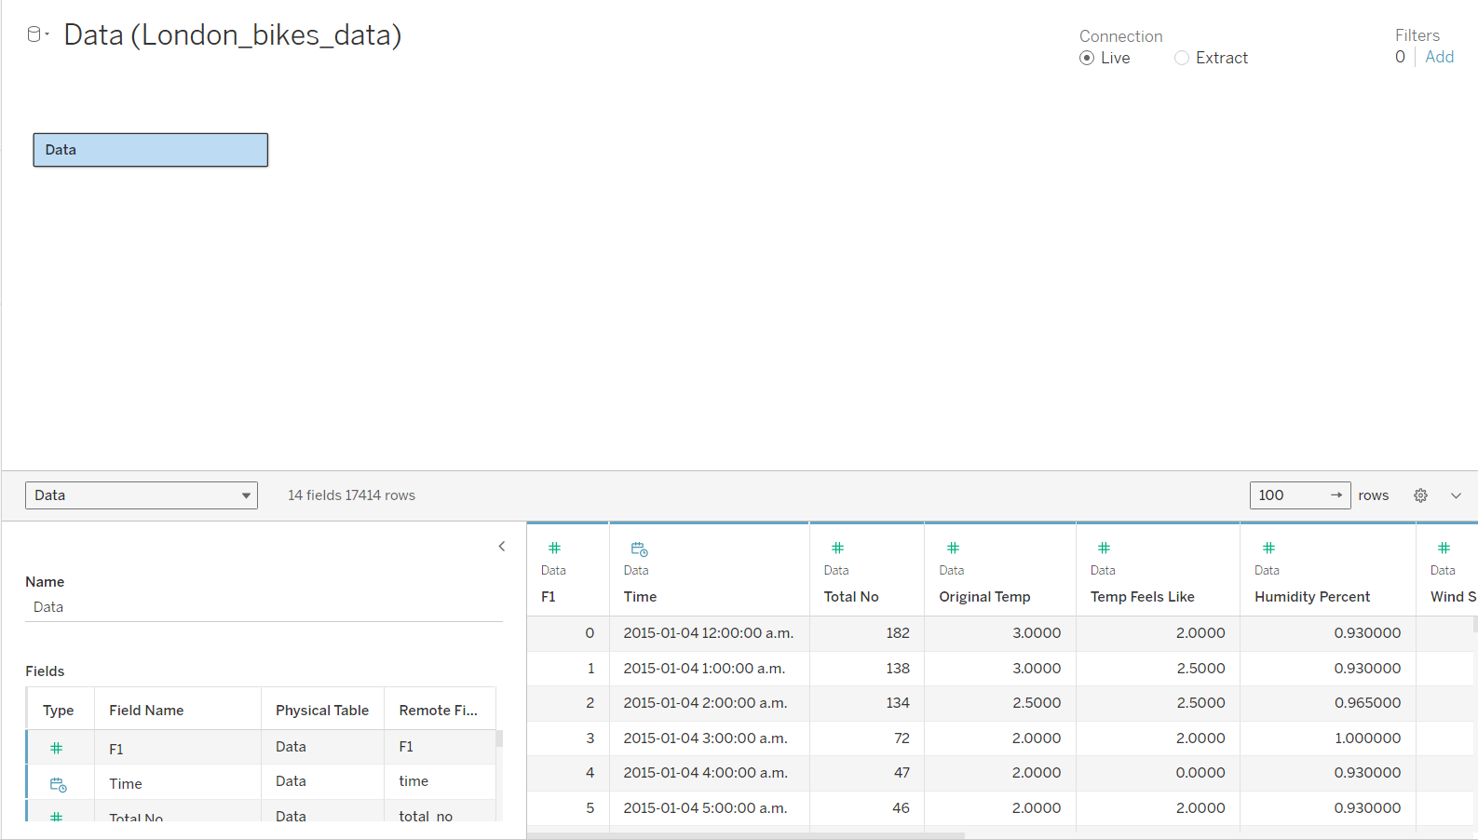

Slide 5
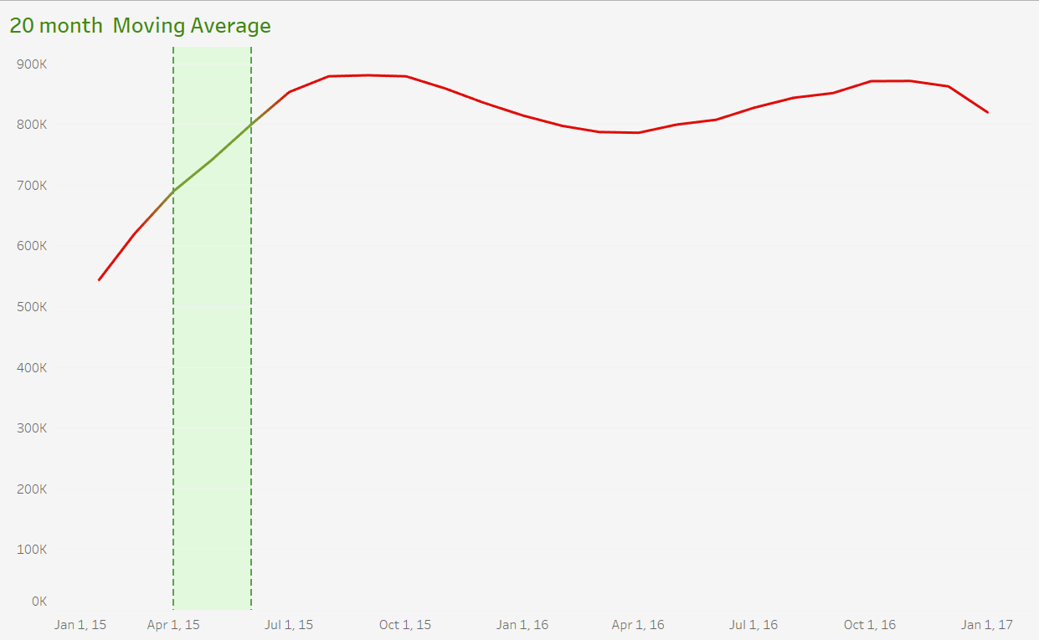
In between Green lines shows No. of people during specific selection of timeline
Number of bike Riders
Timeline
SHEET 1

Slide 6
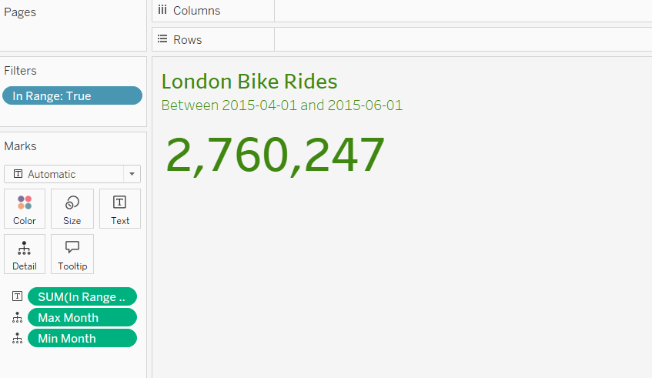
SHEET 2

Slide 7
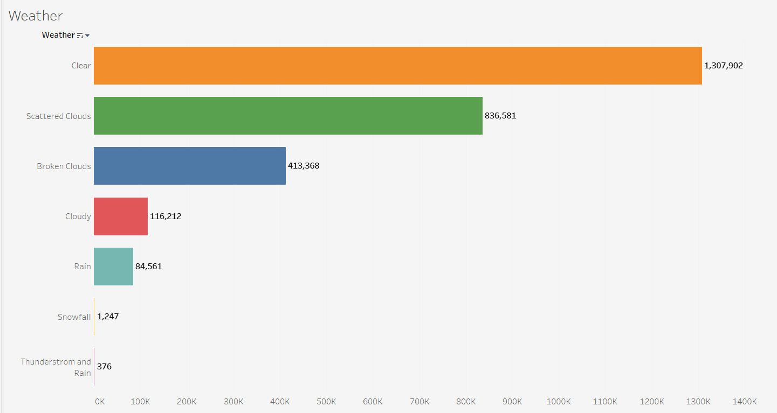
Weather During timeline
Number of bike riders
WORK SHEET 3

Slide 8
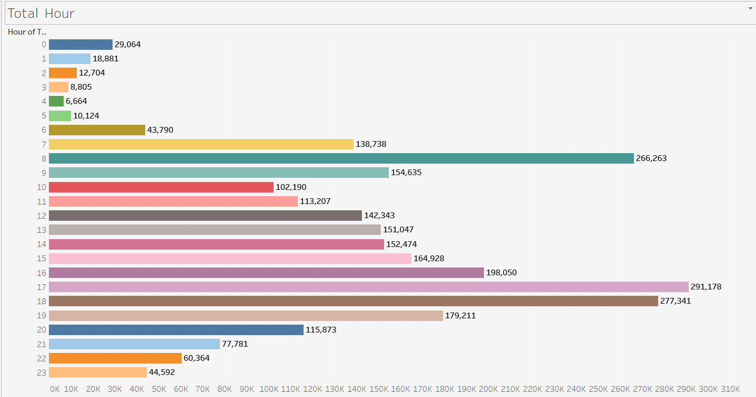
Total time spent During timeline
Number of bike riders
WORKSHEET 5

Slide 9
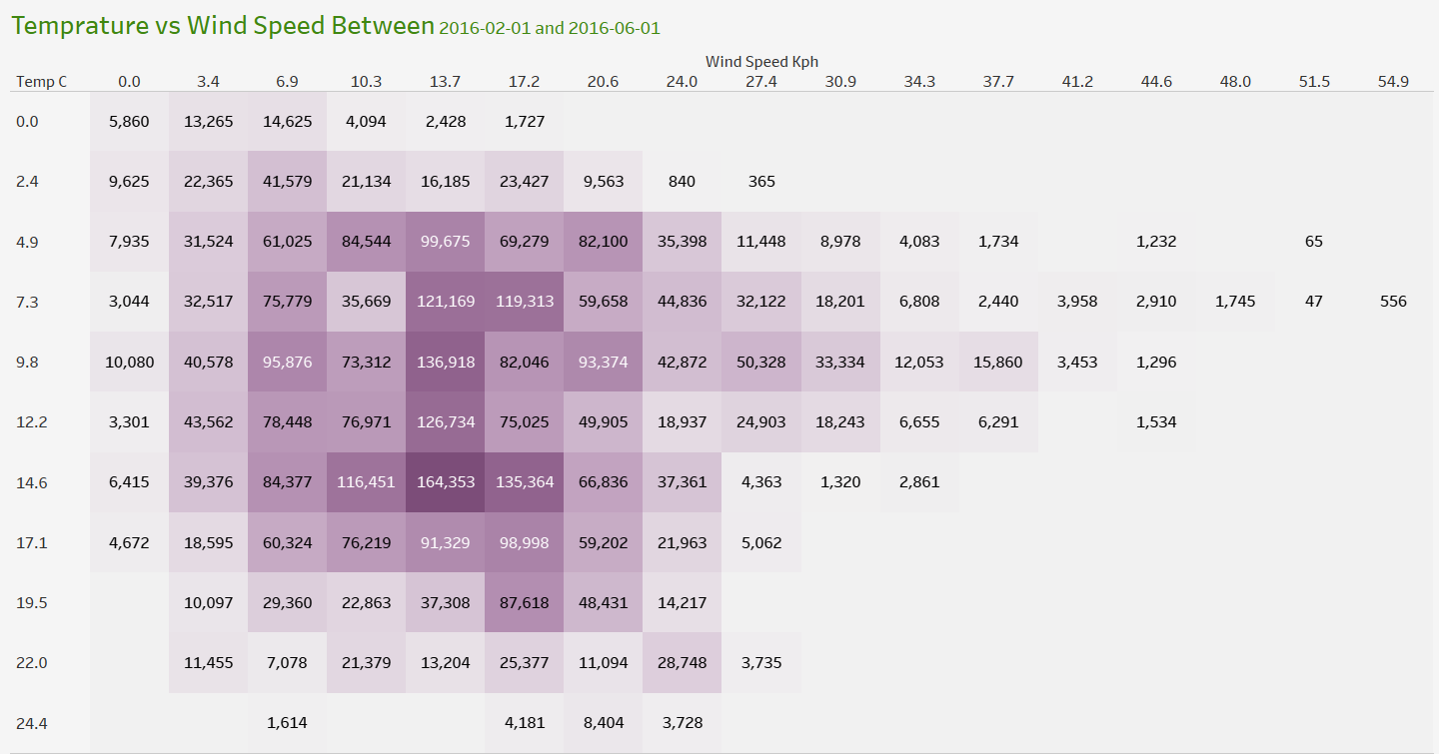
temperature during timeline
No. of people during specific temp and wind speed
Wind Speed
WORKSHEET 6

Slide 10
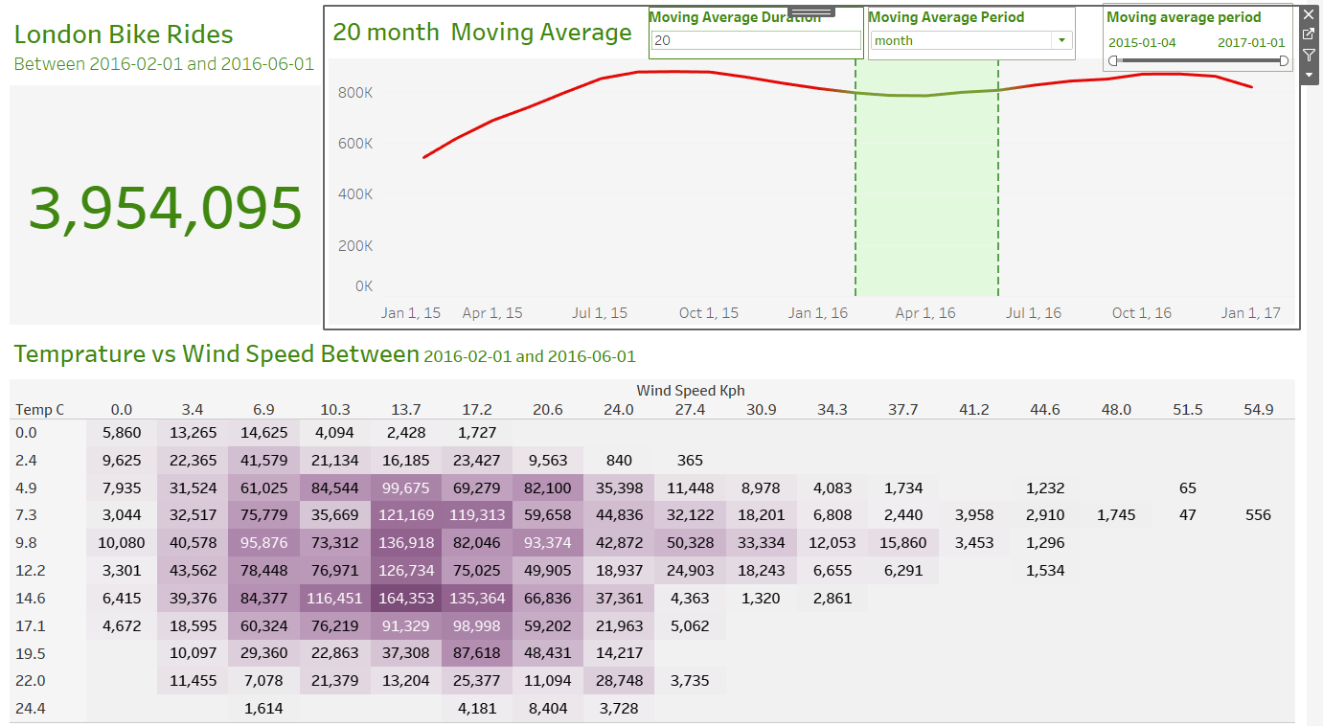
DASHBOARD

Slide 11
THANKYOU

